Slide 1
Creation of Receiver Batch
2025 Internship Interim Presentation

Slide 2
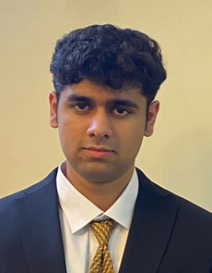
Personal Introduction
Aryan Sudan
Born in New-Delhi, India
Live in IIT-Delhi Campus
Major in Engineering Physics at IIT-Delhi
Interests: Algorithms, Mathematics and Theoretical Physics
Like to play basketball, solve algorithm problems in my free time

Slide 3
Table of Contents
01
The Receive Process
02
My Area of Work
03
Significance
04
Work by Week

Slide 4
Table of Contents (Contd..)
05
Plan for remaining 3 weeks
06
My Learnings (Technical, SCM, Soft Skills)
07
Q&A

Slide 5
The Receive Process
EDH
Systems Send Data to EDH in CSV format
Sys1
Sys2
Sys3

Slide 6
The Receive Process
EDH
Systems Send Data to EDH in CSV format
Sys1
Sys2
Sys3

Slide 7
The Receive Process
EDH stores CSV data in S3 bucket
EDH
S3 Bucket
Systems Send Data to EDH in CSV format
Sys1
Sys2
Sys3

Slide 8


The Receive Process
Talend
EDH triggers Talend
EDH stores CSV data in S3 bucket
EDH
S3 Bucket
Systems Send Data to EDH in CSV format
Sys1
Sys2
Sys3

Slide 9
The Receive Process
JP1 Receive Job calls the EDR
JP1 Scheduler
Talend
EDH triggers Talend
EDR
EDH
S3 Bucket
Systems Send Data to EDH in CSV format
Sys1
Sys2
Sys3

Slide 10
The Receive Process
JP1 Receive Job calls the EDR
JP1 Scheduler
Talend
EDH triggers Talend
EDR
EDH
S3 Bucket
EDR calls Java logic
Java Logic
Sys1
Sys2
Sys3

Slide 11
The Receive Process
JP1 Receive Job calls the EDR
JP1 Scheduler
EDR
EDR calls Java logic
Java Logic

Slide 12
The Receive Process
JP1 Receive Job calls the EDR
JP1 Scheduler
EDR
EDR calls Java logic
Java logic imports records from IF tables into the Business tables.
Java Logic
IF.
BIZ.

Slide 13
The Receive Process
Java Logic
IF.
BIZ.

Slide 14
The Receive Process
My Area of work for last 4 weeks!
Java Logic
IF.
BIZ.

Slide 15
My Area of work
My work in the past 3 weeks: Creation of Receiver Batch: Markdown Ratio Target by BU/3 Digit Dept/Monthly. (IF ID : BIF02177X01)
Purpose: The receiver service merges records from the receiver table into the business table. The reception process used is the IF waiting process. The records for all business units within a particular time zone are loaded into the business table.

Slide 16
My Area of work (Flow)
Rows present in the receiver table but absent in business table are inserted into the business table.
Rows present in both tables, the columns dealing with updating of date, user_id and function_id are updated using the injected attributes: execTime, taskId of the taskContext object.
The receiver service only uses rows yet to be inserted into the business table (IF_PRCS_STS = 0).
Once the rows are successfully inserted into the business table, IF_PRCS_STS item is updated to 2 and columns in IF table are updated.

Slide 17
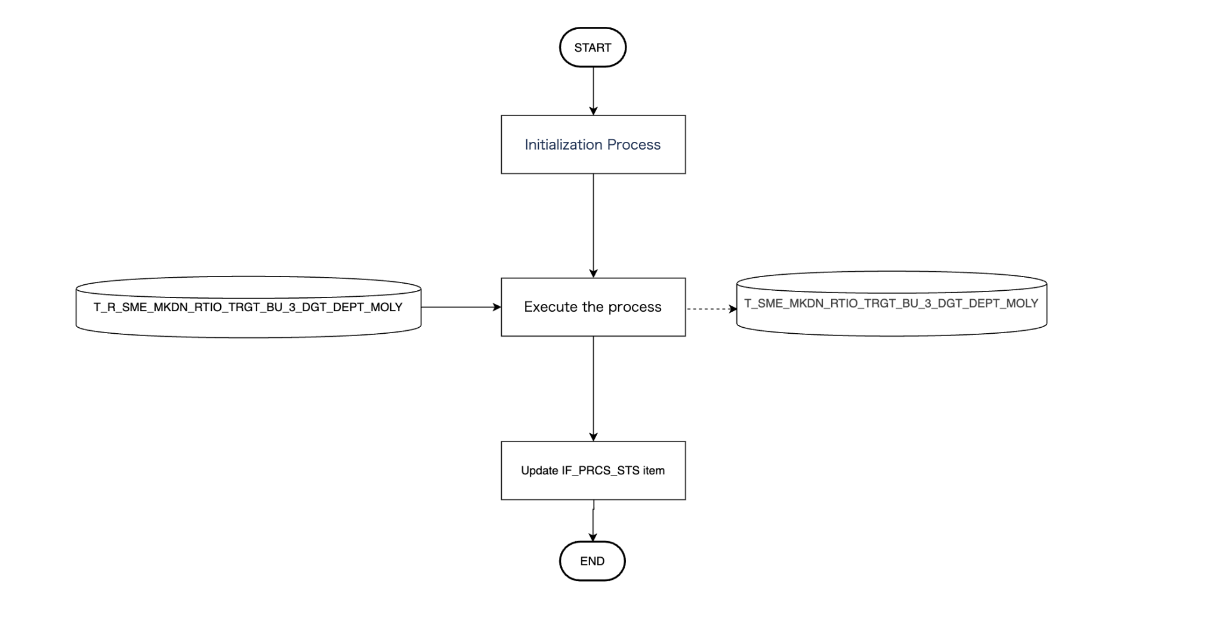

Slide 18
Significance
Batches are backbone of data flow, systems are sent data using which they can carry out a variety of tasks such as making decisions regarding purchase orders, delivery orders, inventory management in warehouses and their replenishment just to name a few.
This process is thus of very high importance.

Slide 19
Work by Week
Week 1 (May 12-16)
PC Setup
Attended KT sessions held by Pratinav San on SCM terminology and batch processes.
Week 2 (May 19-23)
Writing of Java and SQL code for the receiver batch.
Understood setting up of local database for batch unit testing.
Wrote unit tests for testing the receiver service
Attended KT sessions held by Pratinav San.

Slide 20
Work by Week (Contd..)
Week 3 (May 26-30)
Fixed errors with unit tests. Tested coverage and fixed issues using SonarQube
Made changes to PR suggested by Pratinav-San.
Worked on QA sheet for new Jira ticket.
Week 4 (June 2-6)
Fixed SQL code and wrote fresh unit tests.
Made changes to PR suggested by Pratinav-San.
Finished Design Documents for Jira ticket.
Got PR ready for merging with stg. (Attaching screenshots of tests, links and checking checklist)
4th June Branch merged with stg. Testing in staging commences from 9th June . (Deadline for merging with stg was 9th June)

Slide 21
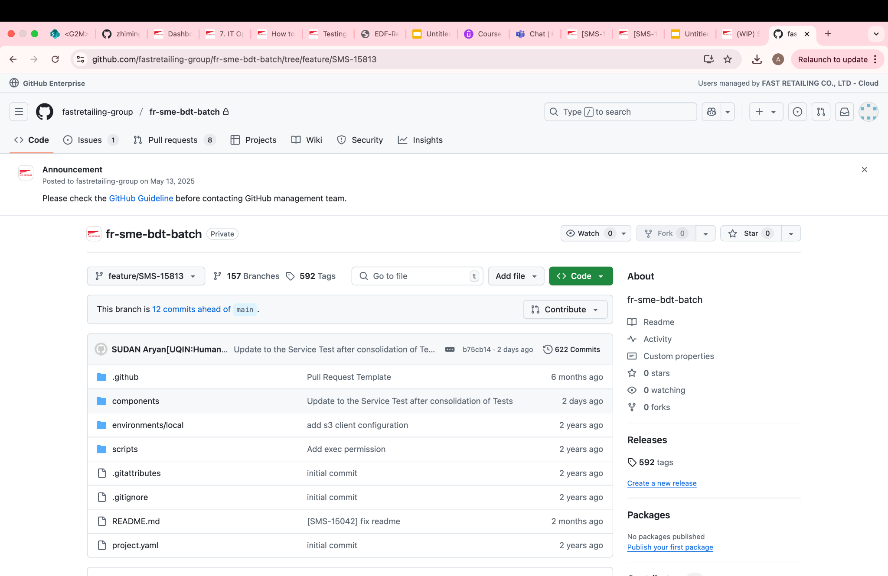
Snapshots (Branch)

Slide 22
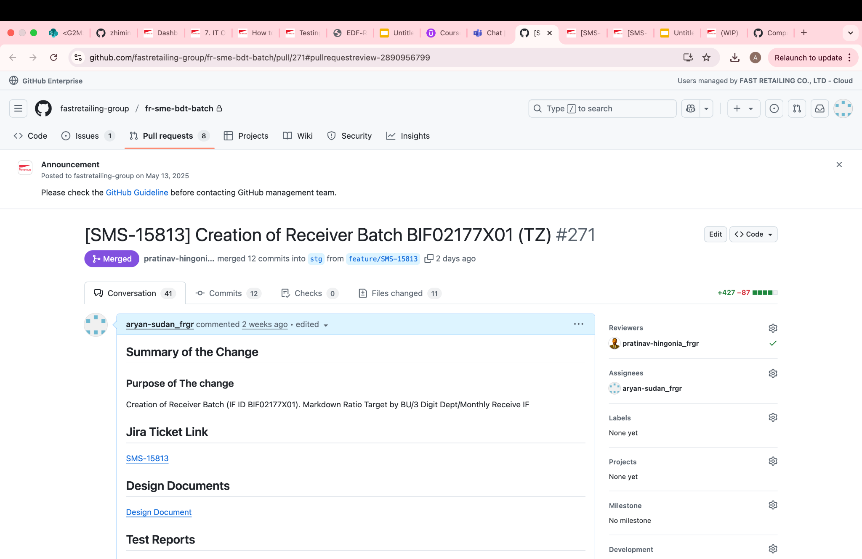
Snapshots (PR)

Slide 23
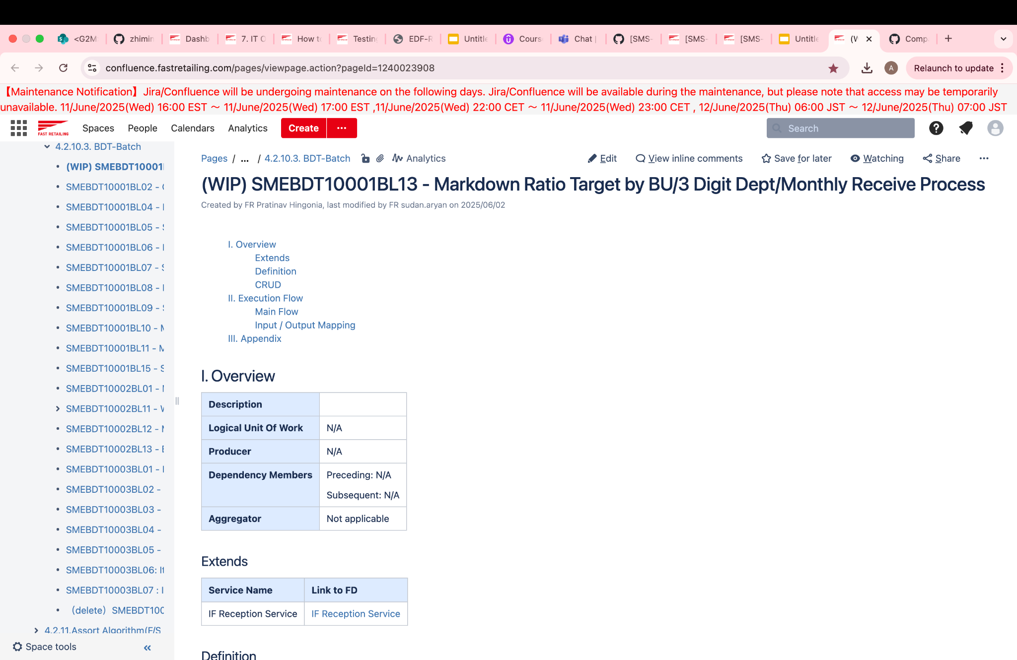
Snapshots (Design Docs)

Slide 24
Plan for remaining 3 weeks
Test Batch in Staging environment and make necessary changes if need arises.
After tests clear, testing in VRF and ultimately batch being deployed to production.
Start work on new Jira ticket on Sender batches and follow same process of Development—> Testing —> Deployment as the Receiver batch.

Slide 25
Learning and Core Competencies (Technical)
SQL: Picked Up SQL and practiced a lot of problems on it, to learn writing optimized queries.
Core Java: This internship allowed me a chance to brush up on Core Java(OOP, Collections Framework etc.)
Spring Framework and Springboot: After getting to know that my project involves Springboot, I undertook a course on Udemy on the same. (In-Progress)
Git and Github: No prior experience with Git. Did a tutorial on it, rookie mistakes.
MacOS terminal and BASH commands: No prior experience with using a MacBook and MacOS terminal. Learnt about most used BASH commands and practiced problems on them.

Slide 26
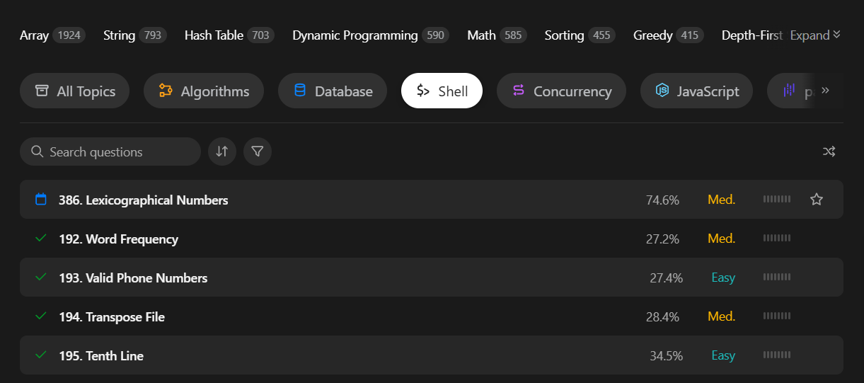
Snapshots
Practiced problems on Bash on Leetcode and Hackerrank

Slide 27
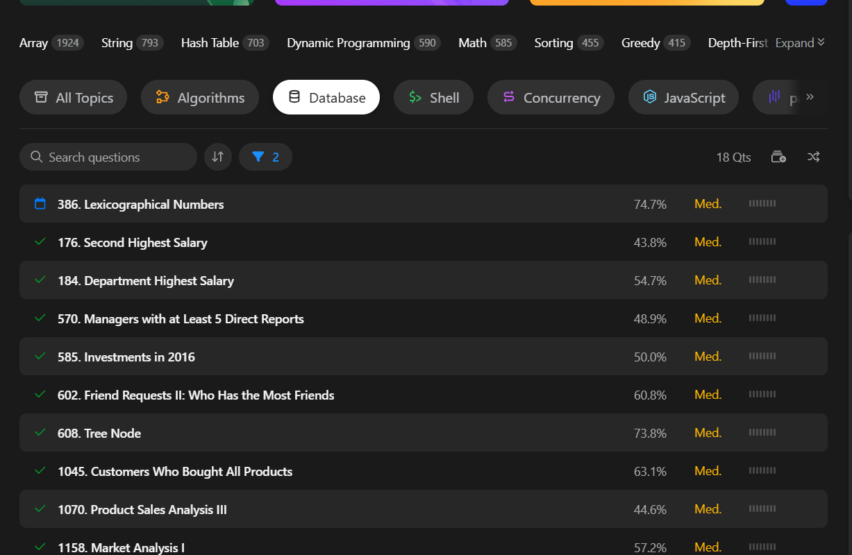
Snapshots
Spent a lot of time practicing SQL on Leetcode to improve query writing

Slide 28
Learning and Core Competencies (SCM)
Batch Processes: Learnt about batches. Deeper insight into Receiver Batch and overview of all other batches. IF receive process, IF waiting receive process. Overview of the whole reception process.
Testing of Receive IFBLs: Tested my batch in staging environment very recently.
SCM terminology : Learnt about the terms used in SCM department.
PC setup, Local Database setup, Unit Testing (Batch), Testing Coverage (SonarQube): Confluence pages and guidance of my mentor Pratinav-San
PR request guidelines: Practical skill of learning how to raise PR requests in the team.

Slide 29
Learning and Core Competencies (Soft Skills)
Asking the right questions: Learnt asking questions that are effective, aren’t obvious and not easily available
Collaboration and Cooperation: I faced challenges in PC setup, local database setup. The learnings from my mentor helped me to help my friend facing similar challenges in the SCM department.
Structuring and documenting work: Daily work reports, following proper structure while writing code.
Taking Feedback and improving: Worked on feedback received from Pratinav-San and She-San.
Adaptability: Never worked remotely before. A little challenging initially but adapted.

Slide 30
Q & A

Slide 31
What contributions I can make to the team ?
Short Term:
Improve the confluence pages: As I learn more about SCM processes, I would be able to write pages that are well written, easily understandable without prior KT sessions. This will help new-joiners and future interns in their work.
Share gained knowledge during KT sessions and internship with others. There is a confluence page on testing of receive IFBLs but not on testing of waiting receive IFBLs. Hope to hold KT sessions and write confluence pages after I complete it.
Long Term:
Learn more about the system and in-depth and hopefully identify and make improvements to it. Keep growing as a software engineer, one who is aware of the business aspects of the work as well.

Slide 32
How FR’s Vision aligns with my Goals ?
Fast Retailing’s vision is to be a trusted brand that has impact far greater than just innovative clothing. Technology powers this vision, be it web and mobile applications, technology in stores and SCM.
I aspire to be an excellent software engineer. The skills and knowledge I acquire during this internship and hopefully full-time training will allow me to contribute my part in Fast Retailing’s vision.
Though, I only have knowledge of a very small section of SCM (Receiver Batches). I am eager to learn more about the other processes and make contributions of much greater significance in the near future.

Slide 33
Thank You Jiang-San for the internship opportunity in your esteemed team
Thank You She-San and Pratinav-San for guiding me and answering my doubts
Thank You Hamamoto-San and HR for smooth on-boarding

Slide 34
SQL logic visualized (Merge)
taskContext Object
procGroupId
taskId
execTime
IF table
IF table = IF_BDT.T_R_SME_MKDN_RTIO_TRGT_BU_3_DGT_DEPT_MOLY

Slide 35
SQL logic visualized (Merge)
taskContext Object
procGroupId
taskId
execTime
IF table
gnrl
bulk
Inner Joins between gnrl and bulk to create a mapping between Process Group Id and BU_ID
IF table = IF_BDT.T_R_SME_MKDN_RTIO_TRGT_BU_3_DGT_DEPT_MOLY
gnrl =
BIZ_BDT.SY_M_SME_GNRL_CD_DTL
bulk =
BIZ_BDT.SY_M_SME_PRCS_GRP_BU_LK

Slide 36
SQL logic visualized (Merge)
taskContext Object
procGroupId
taskId
execTime
IF table
gnrl
bulk
Inner join between IF table and mapping between process group Id and BU_ID to get all records belonging to a particular process group Id
IF table = IF_BDT.T_R_SME_MKDN_RTIO_TRGT_BU_3_DGT_DEPT_MOLY
gnrl =
BIZ_BDT.SY_M_SME_GNRL_CD_DTL
bulk =
BIZ_BDT.SY_M_SME_PRCS_GRP_BU_LK

Slide 37
SQL logic visualized (Merge)
taskContext Object
procGroupId
taskId
execTime
IF table
gnrl
bulk
Now all BU_IDs are mapped to a Process Group ID and records not in business table (IF_PRCS_STS = 0), can be loaded into it
IF table = IF_BDT.T_R_SME_MKDN_RTIO_TRGT_BU_3_DGT_DEPT_MOLY
gnrl =
BIZ_BDT.SY_M_SME_GNRL_CD_DTL
bulk =
BIZ_BDT.SY_M_SME_PRCS_GRP_BU_LK

Slide 38
SQL logic visualized (Merge)
taskContext Object
procGroupId
taskId
execTime
IF table
gnrl
bulk
Insert records into business table
BIZ table
IF table = IF_BDT.T_R_SME_MKDN_RTIO_TRGT_BU_3_DGT_DEPT_MOLY
gnrl =
BIZ_BDT.SY_M_SME_GNRL_CD_DTL
bulk =
BIZ_BDT.SY_M_SME_PRCS_GRP_BU_LK
BIZ table = BIZ_BDT.T_SME_MKDN_RTIO_TRGT_BU_3_DGT_DEPT_MOLY

Slide 39
SQL logic visualized (Merge)
taskContext Object
procGroupId
taskId
execTime
IF table
gnrl
bulk
Using attributes of taskContext object.
BIZ table
IF table = IF_BDT.T_R_SME_MKDN_RTIO_TRGT_BU_3_DGT_DEPT_MOLY
gnrl =
BIZ_BDT.SY_M_SME_GNRL_CD_DTL
bulk =
BIZ_BDT.SY_M_SME_PRCS_GRP_BU_LK
BIZ table = BIZ_BDT.T_SME_MKDN_RTIO_TRGT_BU_3_DGT_DEPT_MOLY

Slide 40
SQL logic visualized (Update IF)
taskContext Object
procGroupId
taskId
execTime
IF table
gnrl
bulk
Update status (IF_PRCS_STS) to 2 for rows inserted into business table and using attributes of taskContext object, update columns in IF table
IF table = IF_BDT.T_R_SME_MKDN_RTIO_TRGT_BU_3_DGT_DEPT_MOLY
gnrl =
BIZ_BDT.SY_M_SME_GNRL_CD_DTL
bulk =
BIZ_BDT.SY_M_SME_PRCS_GRP_BU_LK

